Slide 1
EMPLOYEE SALARY PREDICTION
CAPSTONE PROJECT
Presented By:
Sanaboina Vamsi Naga Sai - Sri Vasavi Engineering – CSE STU6587ad22a369a1703390498

Slide 2
OUTLINE
Problem Statement (Should not include solution)
System Development Approach (Technology Used)
Algorithm & Deployment (Step by Step Procedure)
Result
Conclusion
Future Scope(Optonal)
References

Slide 3
Problem Statement
This project aims to develop a robust machine learning model to predict employee salaries based on a dataset containing various professional and demographic attributes. The core problem is to accurately estimate an individual's salary given factors such as age, gender, education level, job title, and years of experience. By building and evaluating different regression models, we seek to identify the best-performing approach for this prediction task. The resulting model could be valuable for companies in determining fair compensation, for individuals negotiating salaries, or for analyzing salary trends in the job market

Slide 4
System Approach
The "System Approach" section outlines the overall strategy and methodology for developing and implementing. Here's a suggested structure for this section:
System requirements:
Processor (CPU): A modern dual-core processor (e.g., Intel i3, AMD Ryzen 3, or equivalent).
Memory (RAM): 4 GB. The dataset and model objects will comfortably fit within this amount of memory.
Storage: 2 GB of free space to accommodate Python, the required libraries, the dataset, and the notebook file.
Operating System: Windows, macOS, or Linux.
GPU: Not required. All models in the notebook run on the CPU.

Slide 5
System Approach
Library required to build the model:
pandas
numpy
scikit-learn
xgboost
joblib
matplotlib
seaborn
plotly

Slide 6
Algorithm & Deployment
Step 1: Setup and Library Imports:
First, set up your programming environment by importing all the necessary Python libraries. These libraries provide the tools for data handling, analysis, visualization, and machine learning.
Core Libraries: pandas for data manipulation, numpy for numerical operations.
Visualization: matplotlib, seaborn, and plotly for creating charts to understand the data.
Machine Learning: scikit-learn for data preprocessing, model training, and evaluation, plus xgboost for the XGBoost model.
Model Saving: joblib to save the final trained model.
Step 2: Data Loading, Cleaning, and Exploration:
Next, load and prepare the dataset for analysis.
Load the Data: Read the Salary Data.csv file into a pandas DataFrame.
Initial Inspection: Examine the data's shape (df.shape), the first few rows (df.head()), data types (df.info()), and basic statistics (df.describe()) to get a general understanding.
Handle Missing Values: Check for any null or missing values (df.isna().sum()) and remove the corresponding rows (df.dropna()).
Remove Duplicates: Identify and remove any duplicate entries (df.drop_duplicates()) to ensure data quality.
Data Correction: Convert numerical columns like Age and Salary from floating-point numbers to integers (.astype(int)) for consistency. Remove any illogical data, such as negative age or salary.

Slide 7
ALGORITHM AND DEPLOYMENT
Step 3: Feature Engineering:
Create new, insightful features from the existing ones to potentially improve the model's predictive power.
Create Experience_Level: Categorize the Years of Experience into levels like 'Entry-level', 'Mid-level', and 'Senior-level'.
Create Job_Education Interaction: Combine the Job Title and Education Level into a single feature to capture the unique interaction between them.
Create Polynomial Feature: Add a squared version of Years of Experience (Years_of_Experience_sq) to help the model learn non-linear relationships. Step 4: Data Preprocessing and Transformation:
Transform the features into a standardized, numerical format suitable for machine learning models.
One-Hot Encoding: Convert categorical features (Gender, Education Level, Job Title, etc.) into a numerical format using OneHotEncoder.
Feature Scaling: Standardize the numerical features (Age, Years of Experience) using StandardScaler to bring them to a common scale.
Apply Transformations: Use a ColumnTransformer to apply these different preprocessing steps to the appropriate columns efficiently.

Slide 8
ALGORITHM AND DEPLOYMENT
Step 5: Splitting the Data:
Divide the processed dataset into two parts: one for training the models and one for testing their performance on unseen data.
Features and Target: Separate the dataset into features (X), which are the input variables, and the target variable (y), which is the Salary column you want to predict.
Split: Use the train_test_split function to create training sets (X_train, y_train) and testing sets (X_test, y_test), typically with an 80/20 ratio.
Step 6: Model Selection and Training
Select and train several different regression models on the prepared training data.
Models: The notebook trains four distinct models:
Linear Regression
Decision Tree Regressor
Random Forest Regressor
XGBoost Regressor
Training: Fit each model using the X_train and y_train data.

Slide 9
ALGORITHM AND DEPLOYMENT
Step 7: Model Evaluation:
Assess how well each trained model performs by comparing its predictions against the actual salaries in the test set.
Prediction: Use each trained model to make salary predictions on the X_test data.
Evaluation Metrics: Compare the model's predictions with the actual y_test values using key metrics:
R-squared (R2): Measures the proportion of the variance in salary that is predictable from the features.
Mean Absolute Error (MAE): The average absolute difference between predicted and actual salaries.
Root Mean Squared Error (RMSE): The square root of the average of squared differences, which penalizes larger errors more.
Identify Best Model: Compare the metrics across all models to determine the best performer. The best model will have the highest R-squared and the lowest error (MAE, RMSE). In your notebook, the XGBoost Regressor was the top performer.
Step 8: Finalizing the Model:
The final step is to save the best-performing model for future use, so you don't have to retrain it every time.
Save Model: Use the joblib library to save the trained XGBoost Regressor model to a file. This file can then be loaded later to make new salary predictions.

Slide 10
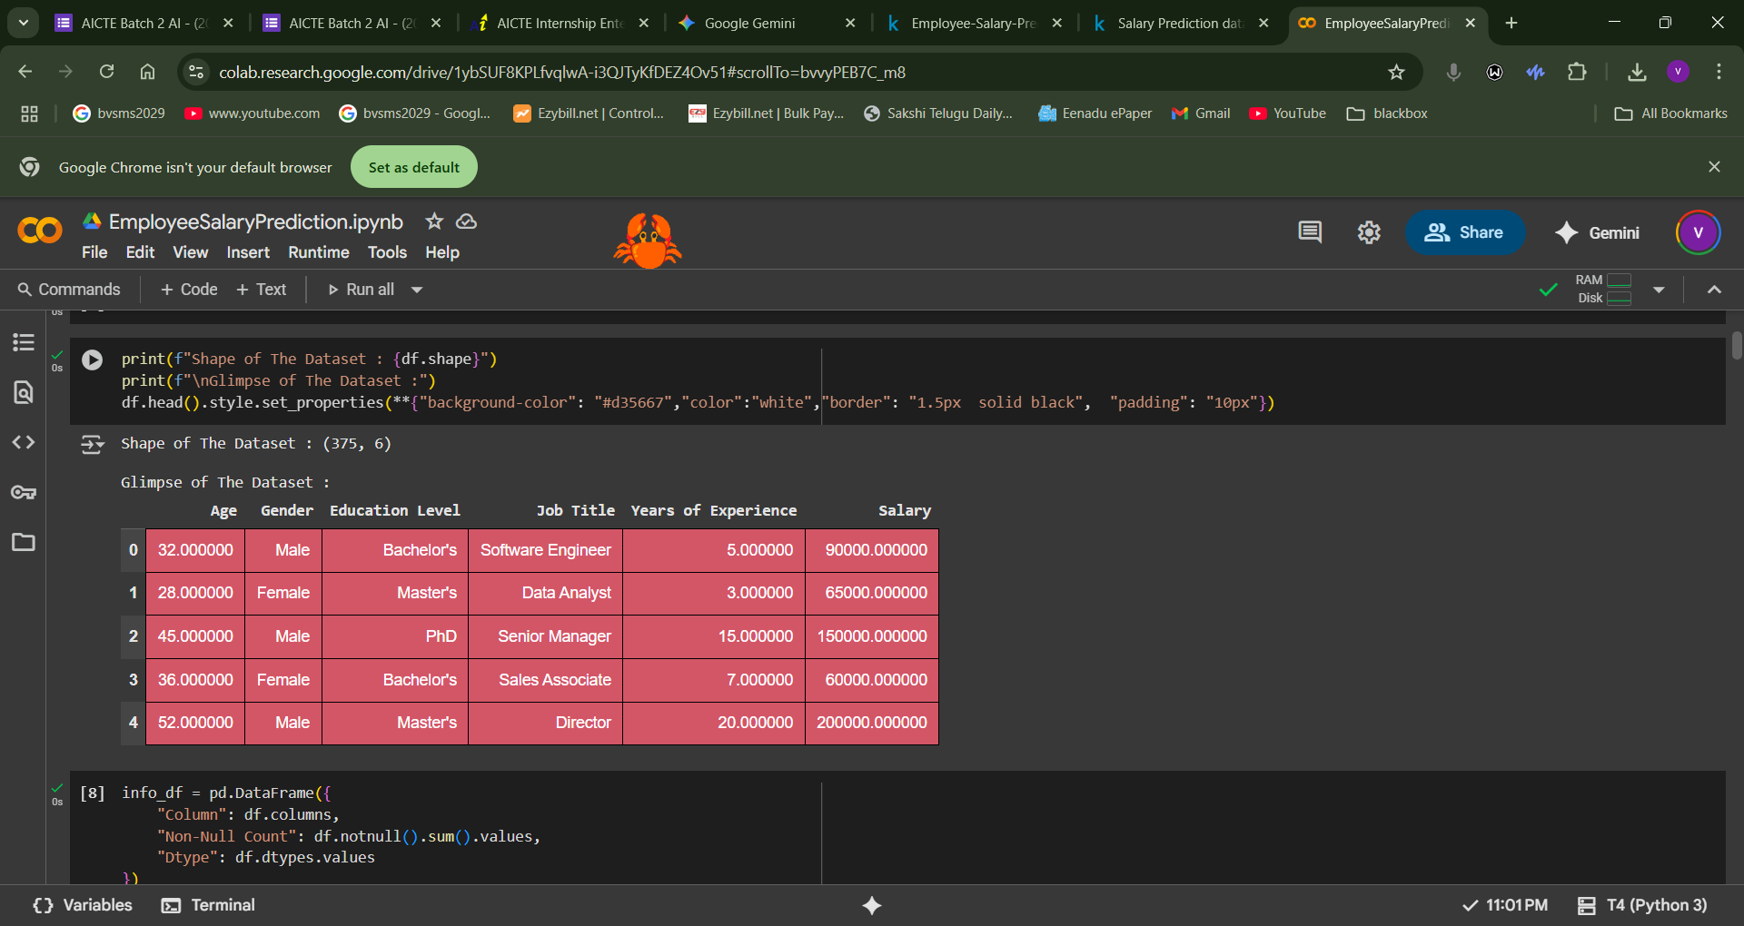
Result

Slide 11
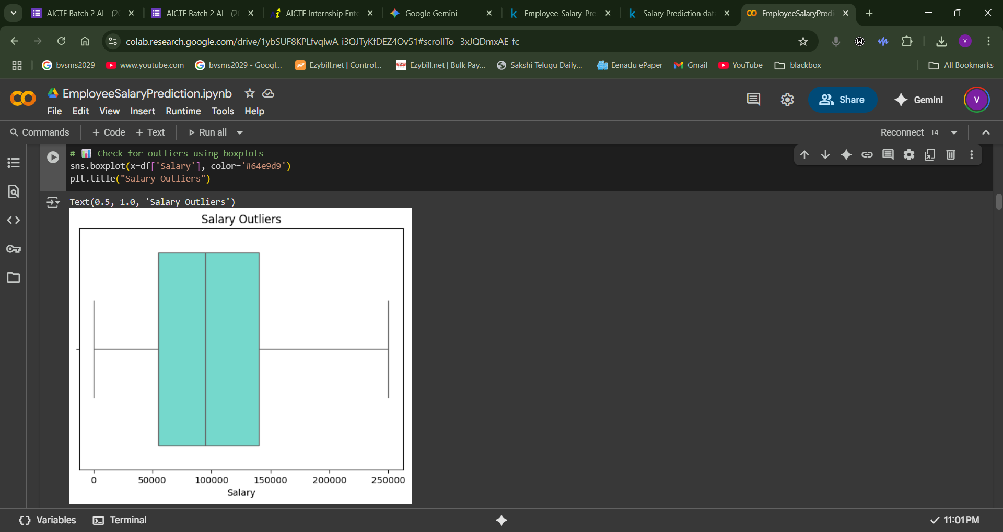
Result

Slide 12
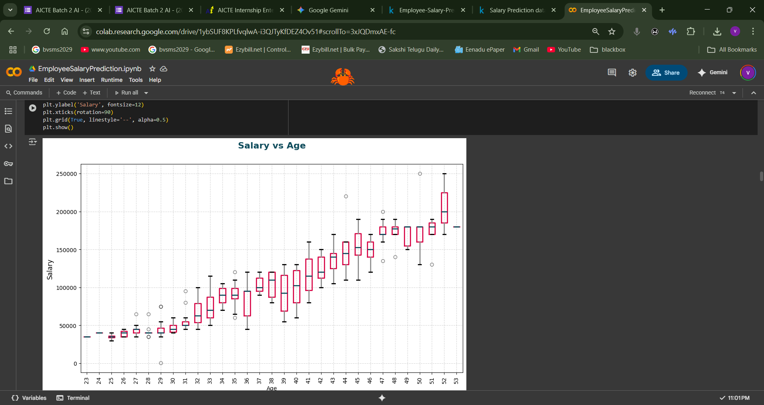
Result

Slide 13
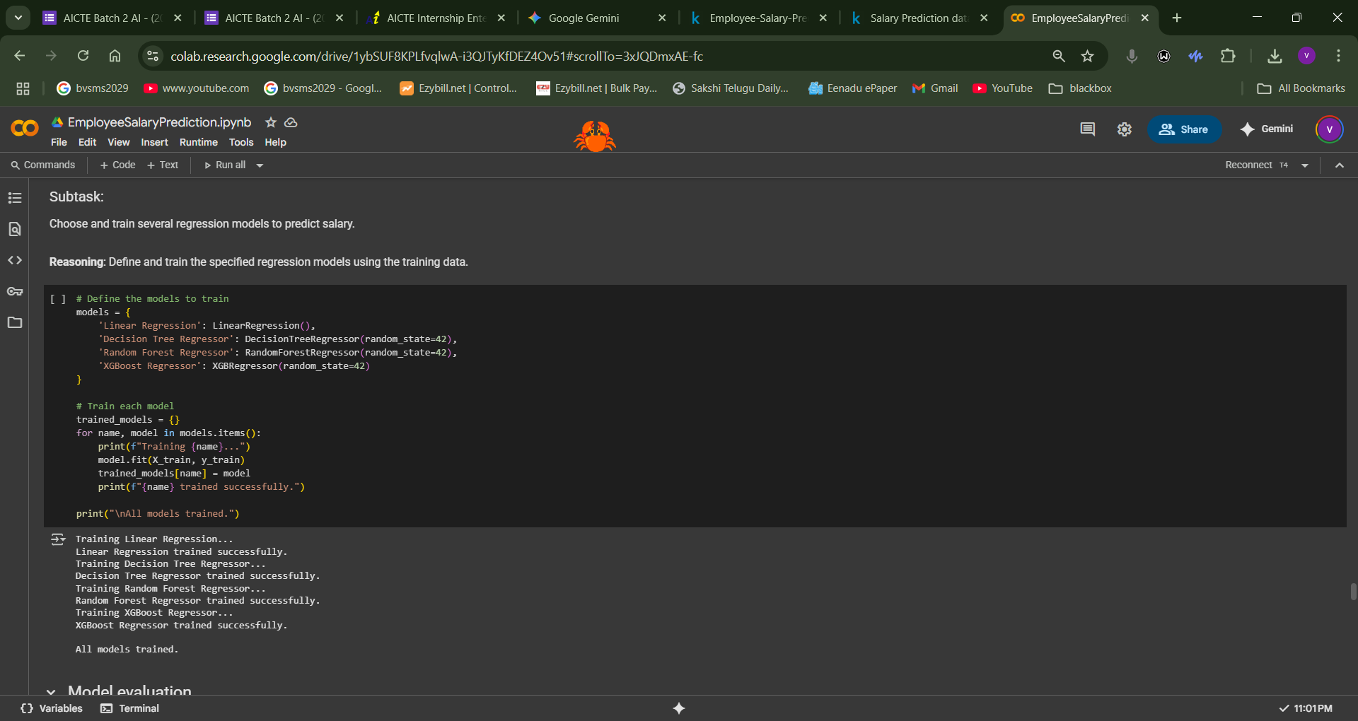
Result

Slide 14
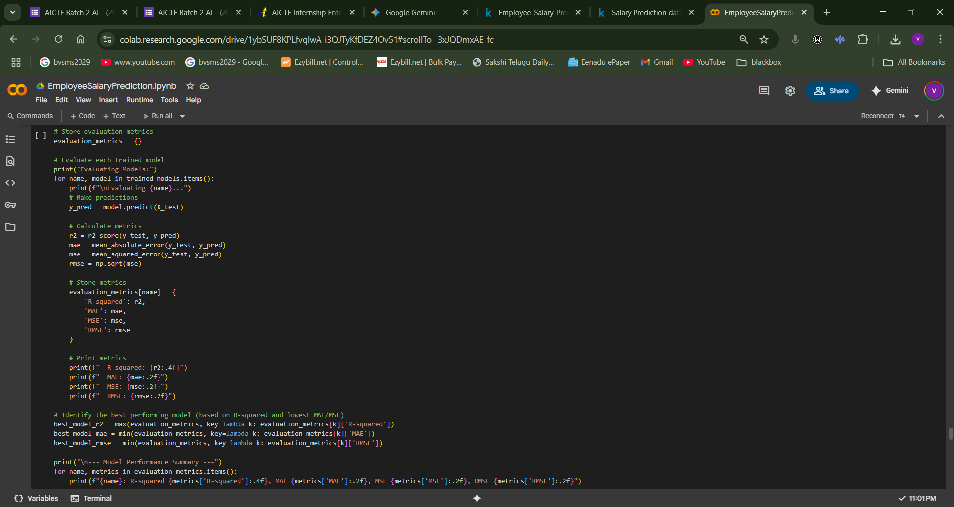
Result

Slide 15
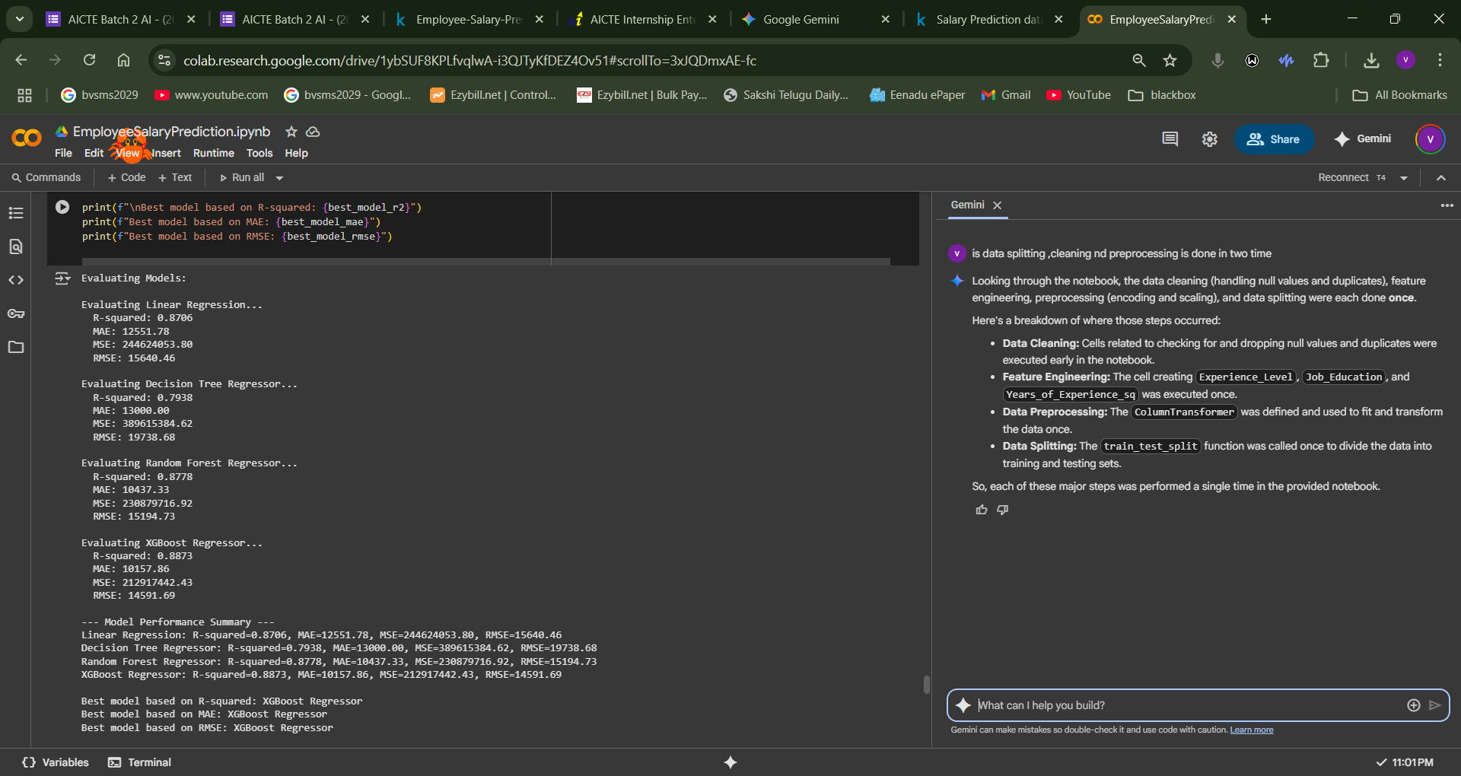
Result

Slide 16
Result
GIT HUB LINK :https://github.com/Vamsi0116/Employee-Salary-Prediction

Slide 17
Conclusion
Summary of Findings:
The primary goal was to build a machine learning model capable of accurately predicting employee salaries based on various professional and demographic attributes. The analysis confirmed that key factors like Years of Experience, Job Title, and Education Level are strong predictors of salary.
After cleaning the data, engineering new features, and training four different regression models, the XGBoost Regressor was identified as the best-performing model. It achieved an R-squared (R2) of 0.8873, indicating it could explain approximately 88.7% of the variance in salary.
Effectiveness of the Proposed Solution
The proposed solution was highly effective. An R-squared value of nearly 89% demonstrates a strong predictive capability for this type of problem. The effectiveness can be attributed to several key steps in the process:
Thorough Data Cleaning: Systematically handling missing values and duplicates created a reliable dataset for training.
Insightful Feature Engineering: Creating features like Experience_Level and the Job_Education interaction term likely helped the models capture more complex patterns in the data.
Systematic Preprocessing: The use of one-hot encoding for categorical variables and standardization for numerical features ensured the data was in an optimal format for the algorithms.
Comparative Model Selection: By training and evaluating multiple models (Linear Regression, Decision Tree, Random Forest, and XGBoost), the project ensured that the most suitable algorithm was chosen.

Slide 18
CONCLUSION
Potential Improvements
While the current model is strong, several steps could be taken to further enhance its performance and robustness:
Hyperparameter Tuning: The models were trained with their default settings. Using techniques like GridSearchCV or RandomizedSearchCV to fine-tune the hyperparameters of the XGBoost Regressor could yield even better accuracy.
Advanced Feature Engineering: The high number of unique job titles could be managed by grouping less common titles into an "Other" category. This would reduce the model's complexity and could improve its ability to generalize.
Cross-Validation: While a standard train-test split was used, implementing a k-fold cross-validation strategy would provide a more robust and reliable measure of the model's performance on unseen data.
Explore Other Models: Advanced gradient boosting models like LightGBM or CatBoost could be trained and compared, as they often provide competitive or even superior performance to XGBoost. Challenges Encountered
While the project was successful, the implementation addressed several common data challenges:
Data Quality Issues: The initial dataset contained both missing values and duplicate entries, which had to be identified and removed to prevent an inaccurate or biased model.
High Cardinality in Categorical Features: The Job Title feature had a large number of unique values (174). This was managed using one-hot encoding, but it resulted in a significant increase in the number of columns (dimensionality), which can make modeling more complex.
Data Integrity: The presence of illogical data points (e.g., salaries or ages of zero or less) required an extra cleaning step to ensure the data was realistic and valid.

Slide 19
Future scope(Optional)
Fine-Tune the Best Model: Make the best model (XGBoost) even more accurate by adjusting its internal settings to better fit the data.
🔧 Improve the Data Features: Simplify the job titles by grouping the rare ones into an "Other" category. This can help the model learn better without getting confused by too many options.
🧪 Test More Advanced Models: Try other popular and powerful models (like LightGBM or CatBoost) to see if they can predict salaries even more accurately.
✅ Build a Real-World Application: Create a simple app or a web page where someone could enter an employee's details (like experience, job title, and education) and get an instant salary estimate from the model.

Slide 20
References
"A Data Mining Based System for Salary Prediction" - (IEEE Xplore)
This research paper discusses building a system for salary prediction using various data mining techniques, providing an academic perspective on the problem.
Link: https://ieeexplore.ieee.org/abstract/document/8464878
"Salary Prediction with Python" - (Towards Data Science)
A practical, step-by-step guide on building a salary prediction model, covering many of the same steps as your notebook, such as data cleaning, feature engineering, and model evaluation.
Link: https://towardsdatascience.com/salary-prediction-with-python-948c345b821

Slide 21
THANK YOU

